Slide 1

BFX-UA300 model’s CPU Delaminated
PE : Nam
2022/11/17

Slide 2
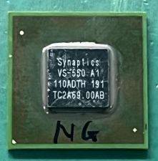
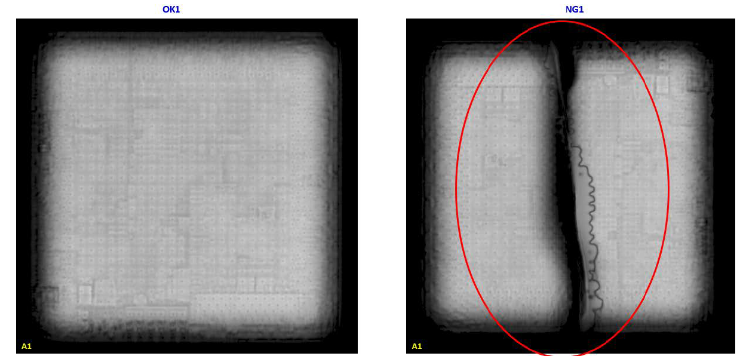
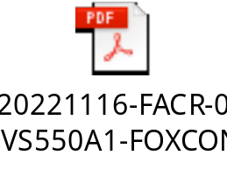
#1
Problems description
VI of Factory | C-Scan image of Vendor
There was some scratches on the surface but didn’t cracked
SoC OK
SoC delaminated
Fii encountered this symptom for the first time.
According to the image of the report, this component is suspected of delamination.
Here are a few possible causes of delamination component:
  Factory received PCBA from RD, maybe the process of transporting PCBA from RD to the factory too long makes CPU being sensitive to moisture → During component swapping used high temperatures, leading to delamination of CPU.
  Moisture sensitive components issue can come from anywhere.

